Slide 1
Lesson 12:
Exception-Handling In Java
Nature is Structured in Layers

Slide 2
Wholeness Statement
Exception handling can be organized in layers with each handler re-establishing a safe state at a given level so the user can continue executing or terminate gracefully. The Universe is also structured in layers with different laws of nature organizing and establishing the order at each level in creation.

Slide 3
What Is Exception-Handling?
Problems can arise during execution of an application:
  Try to open a file but can't
  Try to access a database, but it's unavailable
  Try to save data, but disk is full
  Try to call a method on a null object reference
  Try to access an array index beyond the defined array length
  Try to divide a number by 0
  Try to make an illegal downcast

Slide 4
Exception Handling
Should be handled in one of two ways (depending on the situation):
  Return to a safe state and enable the user to execute other commands
    - for example, the user accidentally inputs incorrect data, such as an incomplete phone number – the application should ask the user to try again
  Allow the user to save all work and terminate the application gracefully
    - for example, a database may not be accessible, so the user could be allowed to "try again later”

Slide 5
What is the right way to accomplish this objective?
It used to be common that error conditions were handled by returning to a calling function an "error code", such as –1, to indicate that some operation has failed or problem has occurred.
  In case many different types of problems need to be anticipated, there could be many different error codes.
  The calling function would then have to decipher these codes and determine a course of action in each case

Slide 6
Two Problems with This Approach
Violation of Open-Closed Principle
Confusion with data

Slide 7
Violation of Open-Closed Principle
Suppose initially, the developer thinks there are just two possible problems that might arise
  if one problem arises, -1 is returned
  if the other problem arises, -2 is returned
The error-handling code in the calling function has to handle each error condition

Slide 8
int saveData(String s) {
int result = openFile("Special File");
if (result == -1) {
return -1;
} else {
result = writeToFile(s);
if (result == -1) return -2;
else return 0;
}
}
callingFunction(String s) {
int code = saveData(s);
if (code == -1) {
handleOpenFileError();
} else if(code == -2) {
handleWriteToFileError();
} else {
doTheNormalThing(s);
}
}

Slide 9
The Problem
Suppose later the file has to be closed in saveData
If the "close" operation could fail, then a new condition has to be handled

Slide 10
int saveData(String s) {
int result = openFile("Special File");
if (result == -1) { return –1;
} else {
result = writeToFile(s);
if (result == -1) {
return –2;
} else {
result = closeFile();
If (result==-1) return –3;
else return 0;
}
}
}
callingFunction(String s) {
int code = saveData(s);
if(code == -1) {
handleOpenFileError();
} else if (code == -2) {
handleWriteToFileError();
} else if (code == -3) {
handleCloseFileError();
} else {
doTheNormalThing(s);
}
}

Slide 11
Confusion with Data
If a method, such as saveData, returns an integer, then -1 could represent a valid result rather than an error code
This problem doesn't go away just by picking a number different from –1 to represent an error code

Slide 12
Contrived Example
int contrivedDivide(int a, int b, int c) {
int temp = a / b;
return temp / c;
}
To avoid dividing by zero, could be rewritten as:
int contrivedDivide(int a, int b, int c) {
if(b == 0 || c == 0) return –1;
int temp = a / b;
return temp / c;
}
What’s wrong?

Slide 13
An Object-Oriented Error-Handling Strategy
An error of any kind is represented as a special kind of object
When an error condition arises, an instance of the object is "thrown“, i.e., created by the Java runtime
  (similar to the way an "event" is triggered by a button click or other user action on a GUI)
The client program then "catches" the error-related object, analyzes the information in this object as needed, and performs some action to handle it

Slide 14
Main Point
Java’s exception-handling model supports best practices in handling exceptions that arise during program execution. Likewise, establishing awareness in the home of all the laws of nature results in a life spontaneously lived in accord with natural law.

Slide 15
Classification Of Error-Condition Classes
Error
  Objects in this category belong to the inheritance hierarchy headed by the Error class
Other Unchecked Exceptions
  Unchecked exceptions include all Error objects as well as all objects that belong to the inheritance hierarchy headed by the class RuntimeException
Checked Exception
  Objects in this category belong to the inheritance hierarchy headed by the class Exception but Not to the inheritance hierarchy headed by RuntimeException (for example divide-by-zero
  (ArithmeticException which is a child of
  RuntimeException ))

Slide 16
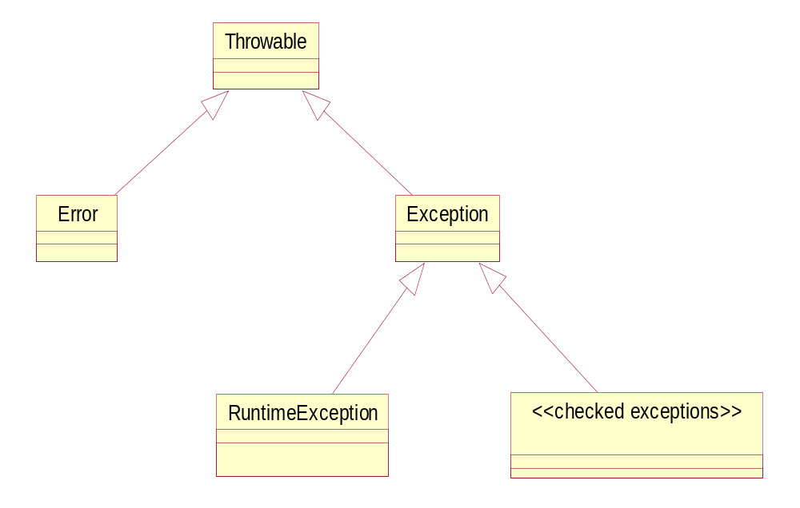
Hierarchy of Exceptions Classes

Slide 17
Objects of type Error
Internal errors, JVM execution errors, or resource exhaustion
  Rare, but if they do occur, the application usually has to be terminated
Nothing is usually done to handle this kind of error
  Since beyond the control of the developer
  E.g., hardware failure, out of memory, etc.
The JVM will handle the Error object by displaying a message to the console indicating the type of Error and the sequence of method calls that led to the error condition (called a stack trace)

Slide 18
StackOverflowError
Usually a logic error (infinite loop)

Slide 19
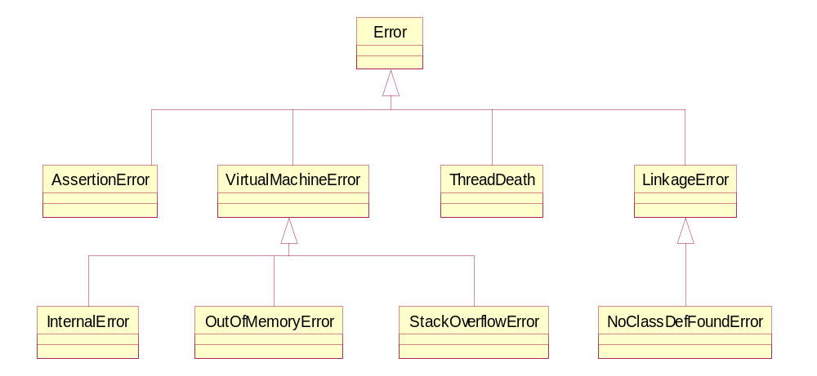
The Error Hierarchy

Slide 20
Other Unchecked Exceptions
Belong to the hierarchy RuntimeException
Generally indicates that the programmer has made a logic error and needs to fix it
Examples:
  NullPointerException
    an object needs to be initialized
  ClassCastException
    improper cast needs to be fixed
  ArrayIndexOutOfBoundsException
    adjust bounds of a loop
  NumberFormatException
    could arise from trying to turn a non-numeric String (like “hello”) into an Integer

Slide 21
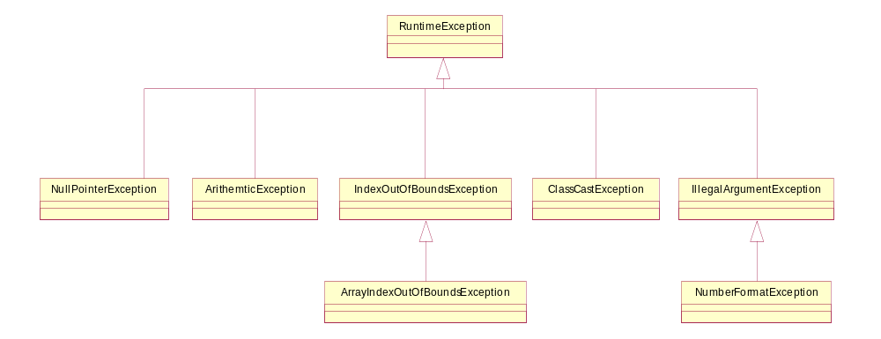
Hierarchy of RuntimeException

Slide 22
At this point go over the first program at the top of the second file.

Slide 23
Checked Exceptions
Considered by the JVM to be the kind of error a developer must be prepared to handle
Examples:
  CloneNotSupportedException
  FileNotFoundException
  ClassNotFoundException
  SQLException
JVM expects the developer to handle any exception of this type
  will issue a compiler error if a program fails to do so

Slide 24
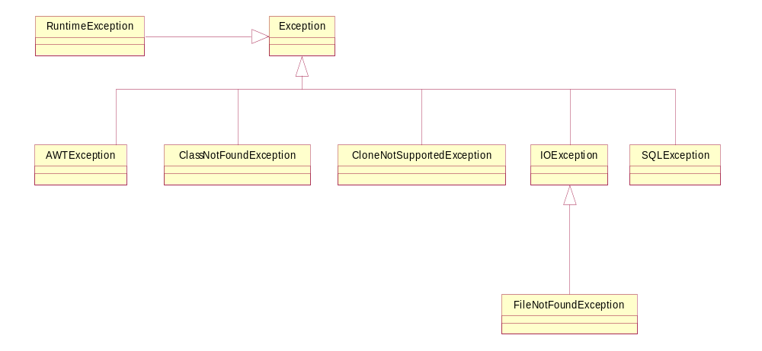
Hierarchy of Checked Exceptions

Slide 25
Dealing With Checked Exceptions
Every method or constructor capable of throwing an Exception in the Checked Exception Hierarchy must indicate this with a throws clause
Examples:
  The clone method in Object:
    protected clone() throws CloneNotSupportedException
  The constructor of the class FileWriter (used for writing text to a file)
    public FileWriter(File file) throws FileNotFoundException

Slide 26
Four ways of dealing with them
Do not attempt to handle directly; instead, declare that your method also throws this kind of exception (the exception goes back to the caller of the method)
Surround the calling code in a try block, then write exception-handling code in a catch block
Surround the calling code in a try block, partially handle the exception in a catch block, and then re-throw the exception to allow other methods in the call stack to handle it further
Surround the calling code in a try block, throw a new kind of exception from within the catch block

Slide 27
Invoking Object's clone method on an
instance that does not implement the
Cloneable interface results in the exception
CloneNotSupportedException being thrown.

Slide 28
Example 1
//Here the exception is not handled directly
//Instead, declare that your method also
//throws this type of exception
class Employee implements Cloneable {
. . . . .
public Object clone()
throws CloneNotSupportedException {
Employee copy = (Employee)super.clone();
copy.hireDate = (Date)hireDate.clone();
return copy;
}
. . . . .
}

Slide 29
Example 2
//Here, we enclose the calling code in a try block, and then
//write exception-handling code in a catch block
class Employee implements Cloneable {
. . . . .
public Object clone() {
try {
Employee copy = (Employee)super.clone();
copy.hireDate = (Date)hireDate.clone();
return copy;
}
catch(CloneNotSupportedException ex) {
System.err.println("Unable to make a copy");
}
}
. . . . .
}

Slide 30
Example 3
//Here we enclose the calling code in a try block, then, in a catch block,
//write some exception-handling code and then re-throw the exception
class Employee implements Cloneable {
. . . . .
public Object clone() throws CloneNotSupportedException {
try {
Employee copy = (Employee)super.clone();
copy.hireDate = (Date)hireDate.clone();
return copy;
}
catch(CloneNotSupportedException ex) {
System.err.println("Unable to make a copy");
throw ex;
}
}
. . . . .
}

Slide 31
Example 4
//Here we enclose the calling code in a try block, then, in catch block,
// optionally some exception-handling code
//and throw an application-specific Exception object
class Employee implements Cloneable {
. . . . .
public Object clone() throws ApplicationSpecificException {
try {
Employee copy = (Employee)super.clone();
copy.hireDate = (Date)hireDate.clone();
return copy;
}
catch(CloneNotSupportedException ex) {
System.err.println("Unable to make a copy");
throw new ApplicationSpecificException();
}
}
. . . . .
}

Slide 32
The code inside a catch block
May gracefully handle the error condition
  in which case the program will continue to run immediately after the catch block
May re-throw the Exception that it just caught
May throw a new Exception of a different type
May cause the application to terminate
  e.g., using System.exit()

Slide 33
Main Point
Methods whose declaration includes a throws clause can be called by another method only if the calling method is declared with the same throws clause, or if a catch block is included for all of the declared exceptions. This phenomenon is reminiscent of the Principle of Diving: once the initial conditions have been met, a correct dive into the depths occurs automatically. (The throws clause is the initial condition; the compiler then automatically requires additional coding in order to handle exceptions that may occur.)

Slide 34
Compiler Errors
An Error exception indicates an internal JVM error or other problem beyond the control of the developer
  No compiler error when there is no try/catch block
  Should not be caught
Other unchecked exceptions are subclasses of type RuntimeException and indicate a programming error that needs to be fixed (null pointer, array bounds, etc.)
  No compiler error when no try/catch block
  Should not be caught
Checked exceptions are subclasses of Exception but are not part of the RuntimeException hierarchy
  A compiler error is issued when no try/catch block around such calls
  Have to be caught or declared in the throws clause

Slide 35
Using/Creating Exception Classes
Sometimes one of Java's pre-defined exception classes will provide a sensible implementation
Example:
  Suppose a method readData attempts to read data from a file that is not the length the header promised
    An exception needs to be thrown

Slide 36
Throwing a Java Exception
String readData(Scanner in) throws EOFException {
. . .
while(true) {
if (!in.hasNext()) { //EOF encountered—may be ok
if (actualLen < PROMISED_LEN) { //something bad happened
String msg = "expected " + promisedLen +
" but got only " + actualLen;
throw new EOFException(msg);
} else {
. . .
}
}
}
}

Slide 37
Using/Creating Exception Classes
Usually, best to create your own Exception class
Define so it is a subclass of Exception
The Exception class has two main constructors
  a default constructor
  a one-argument constructor (of String type) designed to store an error message
  typically, you override both of these

Slide 38
User Defined Exception Classes
public class MyException extends Exception {
public MyException() {
super();
}
public MyException(String msg) {
super(msg);
}
}
‘Maybe’ on the standard exam!

Slide 39
Best Practices
When To Throw
  at the exact point during execution where a problem arises
When To Handle
  by a class that has among its responsibilities the proper knowledge about what should be done
When To Log
  when important to record exceptions for later review by interested parties (developers, business team, etc)

Slide 40
Importance of Logging
Messages presented to the user or printed to the console are not adequate for later review
What is needed is a Log file
Pattern
  Log a warning or error message when the exception first occurs
  Throw an appropriate Exception up the call stack to appropriate controller
  Controller either handles or creates a user exception with a user-appropriate message

Slide 41
Using Sun's Logger
jdk 1.4 introduced the Logger class
Create an instance like this:
  Logger myLogger = Logger.getLogger("com.mycompany.myapp");
Set level of logging that you wish to use:
  myLogger.setLevel(Level.ALL);
When an event occurs during runtime that needs to be logged, insert a line like this
  myLogger.warning("Unauthorized user has attempted "+
  “to perform an action.");

Slide 42
Main Point
To use Exceptions effectively, a message should be logged so that the support team can review it later; the Exception should be thrown up the call stack until a class that knows how to handle the Exception is reached; this final class should catch and handle the Exception in an appropriate way. In a similar way, creation itself is structured in layers; the activity at each layer has its own unique set of governing laws; laws that pertain to one level or layer may not be applicable at another level.

Slide 43
Pitfalls
The following is not good (illegal?) because IOException is a superclass of FileNotFoundException. Why?
try {
. . .
}
catch(IOException ex1) {
. . .
}
catch(FileNotFoundException ex2) {
. . .
}

Slide 44
Corrected
The following is OK because all catch clauses are now reachable. Why?
try {
. . .
}
catch(FileNotFoundException ex2) {
. . .
}
catch(IOException ex1) {
. . .
}

Slide 45
Nesting is OK
The following is sometimes necessary:
try {
. . .
} catch(AnException ex1) {
. . .
try {
. . .
} catch(AnotherException ex2) {
. . .
}
}

Slide 46
The finally Keyword
A finally clause can be introduced after all catch clauses
A finally block is guaranteed to run after any try/catch block,
  even if a return or break occurs
  even if another exception is thrown inside those blocks
  Exception to the rule: If System.exit() occurs in one of the blocks, the finally clause is skipped
A finally clause is used to cleanup resources (like database connections, open files)

Slide 47
Exception-handling Syntax
~ The Whole Picture ~
try {
// normal code (conditionally executes)
}
catch (ExceptionType1 x) {
// handle ExceptionType1 error
}
…
catch (ExceptionTypeN x) {
// handle ExceptionTypeN error
}
finally {
// invariant code ("always" executes)
}

Slide 48
finally Clause Summary
For code that must ALWAYS run
  No matter what!
  Even if a return or break occurs first
  Exception: System.exit( )
Placed after handlers (if they exist)

Slide 49
Do the other file.

Slide 50
CONNECTING THE PARTS OF KNOWLEDGE WITH THE WHOLENESS OF KNOWLEDGE

Slide 51
If a Java method has a throws clause in its declaration, the compiler requires methods that call it to handle potential exceptions.
Exceptions should be handled as follows: log them as soon as the exception is thrown; re-throw the exception up the call stack to a controller method that understands how to handle it; the exception is then caught and appropriate action is taken.

Slide 52
3. Transcendental Consciousness
is home of all the laws of nature, the home of "right action".
4. Impulses Within the Transcendental Field : The impulses within the transcendental field are only created to further the evolution of the individual and the universe.

Slide 53
5. Wholeness moving within itself : Action in the state of Unity Consciousness is spontaneously right and uplifting to the creation as a whole.

